Slide 1

Summer Camp
Embedded Programming Clinic
Summer 2024
Dr. Robbeloth
Associate Professor of Computer Science @ MVNU

Slide 2
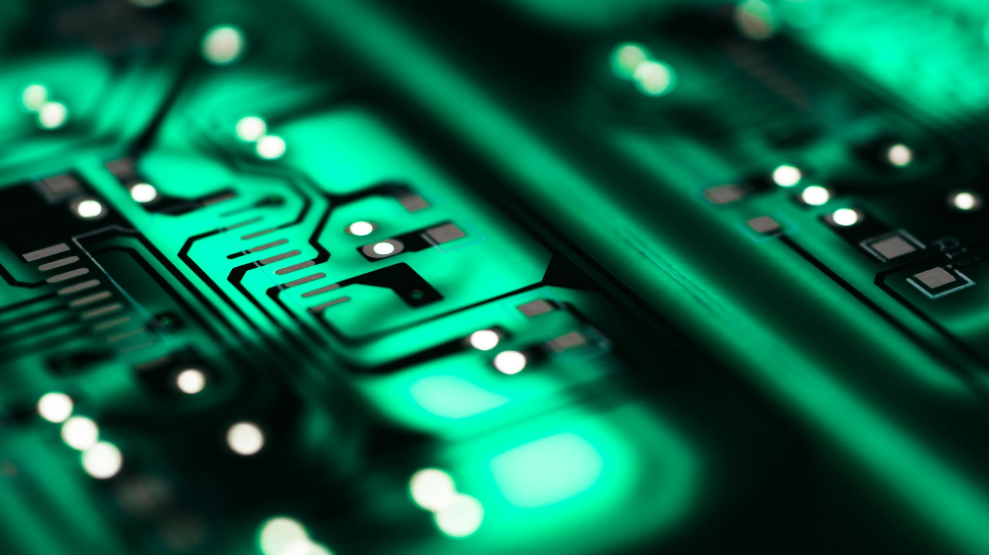
Why do we need programming?
Notes:
Ask students for feedback, write responses on board?
Software Development – create software apps to perform various tasks efficiently
Automation – automate repetitive tasks or processes, saving time & effort, eliminate need for manual intervention
Problem Solving – Break down complex problems into smaller, more manageable parts and develop algorithms or step=by-step instructions to solve them
Scientific and Mathematical Modeling – use in scientific research and mathematical modeling. Simulate complex phenomena, analyze data, and make predictions
Innovation and Creativity – Provide a platform for innovation and creativity. Bring new ideas to live and develop new tech, products, and services.
Career opportunities – Provides a wide range of job opportunities. Programming needed in soft development, data science, cybersecurity, web development, game development, and other areas.
Tell devices capable of computation how to do something.

Slide 3

Software Development
Apps to perform tasks efficiently

Slide 4

Automation
Automate repetitive tasks or processes
Save time/effort
Remove manual interventions
Notes:
Ask students for feedback, write responses on board?
Software Development – create software apps to perform various tasks efficiently
Automation – automate repetitive tasks or processes, saving time & effort, eliminate need for manual intervention
Problem Solving – Break down complex problems into smaller, more manageable parts and develop algorithms or step=by-step instructions to solve them
Scientific and Mathematical Modeling – use in scientific research and mathematical modeling. Simulate complex phenomena, analyze data, and make predictions
Innovation and Creativity – Provide a platform for innovation and creativity. Bring new ideas to live and develop new tech, products, and services.
Career opportunities – Provides a wide range of job opportunities. Programming needed in soft development, data science, cybersecurity, web development, game development, and other areas.
Tell devices capable of computation how to do something.

Slide 5

Problem Solving
Break down complex problems into small, manageable parts
Develop algorithms (step-by-step instructions)
Notes:
Ask students for feedback, write responses on board?
Software Development – create software apps to perform various tasks efficiently
Automation – automate repetitive tasks or processes, saving time & effort, eliminate need for manual intervention
Problem Solving – Break down complex problems into smaller, more manageable parts and develop algorithms or step=by-step instructions to solve them
Scientific and Mathematical Modeling – use in scientific research and mathematical modeling. Simulate complex phenomena, analyze data, and make predictions
Innovation and Creativity – Provide a platform for innovation and creativity. Bring new ideas to live and develop new tech, products, and services.
Career opportunities – Provides a wide range of job opportunities. Programming needed in soft development, data science, cybersecurity, web development, game development, and other areas.
Tell devices capable of computation how to do something.

Slide 6
Scientific and Mathematical Modeling
Programming needed in scientific research and mathematical modeling
Simulate complex phenomena
Analyze data
Make predictions

Slide 7

Innovation and Creativity
Bring new ideas to life
Develop new tech, products, and services
Notes:
Ask students for feedback, write responses on board?
Software Development – create software apps to perform various tasks efficiently
Automation – automate repetitive tasks or processes, saving time & effort, eliminate need for manual intervention
Problem Solving – Break down complex problems into smaller, more manageable parts and develop algorithms or step=by-step instructions to solve them
Scientific and Mathematical Modeling – use in scientific research and mathematical modeling. Simulate complex phenomena, analyze data, and make predictions
Innovation and Creativity – Provide a platform for innovation and creativity. Bring new ideas to live and develop new tech, products, and services.
Career opportunities – Provides a wide range of job opportunities. Programming needed in soft development, data science, cybersecurity, web development, game development, and other areas.
Tell devices capable of computation how to do something.

Slide 8

Make silicon smarter than a dumb rock
Tell devices capable of receiving instructions, how to work
Notes:
Ask students for feedback, write responses on board?
Software Development – create software apps to perform various tasks efficiently
Automation – automate repetitive tasks or processes, saving time & effort, eliminate need for manual intervention
Problem Solving – Break down complex problems into smaller, more manageable parts and develop algorithms or step=by-step instructions to solve them
Scientific and Mathematical Modeling – use in scientific research and mathematical modeling. Simulate complex phenomena, analyze data, and make predictions
Innovation and Creativity – Provide a platform for innovation and creativity. Bring new ideas to live and develop new tech, products, and services.
Career opportunities – Provides a wide range of job opportunities. Programming needed in soft development, data science, cybersecurity, web development, game development, and other areas.
Tell devices capable of computation how to do something.

Slide 9

What do I need to start programming?
Notepad/Notebook
Notes:
Write out requirements
Figure out design
Write algorithms/pseudocode

Slide 10
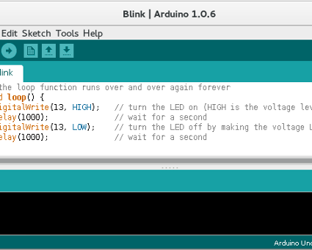
What do I need to start programming?
Development Environment
This Photo by Unknown Author is licensed under CC BY-SA
Notes:
Could be text editor notepad
Could be something fancy like IntelliJ or Visual Studio code
Later in this camp, we’ll use the Arduino development environment (Arduino is also an organization and a type of circuit board)

Slide 11
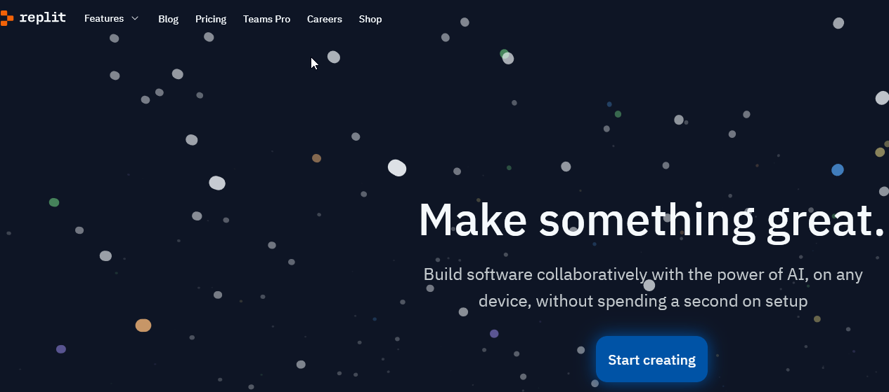
What do I need to start programming?
Could use a website to do your coding
Replit.com
Notes:
Does anyone know what REPL is?
REPL: read, evaluate, print, and loop

Slide 12
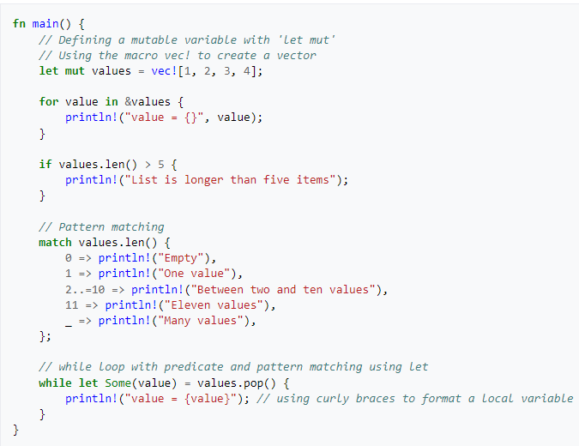
What is one category of programming languages do electrical/computer/embedded engineers use?
System Programming Languages
C, C++, Go, Rust, etc.
Tradeoff: compatibility vs speed and ease of hardware access
Notes:
Rust code, now starting to be added to the Linux kernel (core part of the Linux OS).

Slide 13
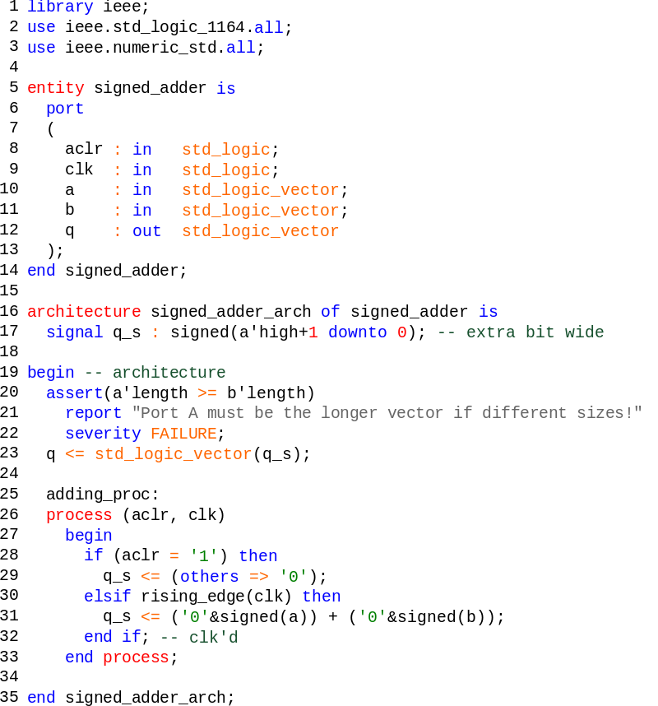
Another category of programming languages used by elec/comp/embedded engineers.
Hardware Description Languages
Verilog and VHDL (on right)
Used with Field Programming Gate Arrays (FPGAs)
Devices that you can write program code for to transform the silicon into different computing devices
Code is synthesized into electronic design resulting in logic gates being wired up on the board
Notes:
FPGA -- a type of integrated circuit that can be reprogrammed after manufacturing.
FPGAs are a type of programmable logic device (PLD) and are made up of a matrix of configurable logic blocks (CLBs) that are connected by programmable interconnects.

Slide 14
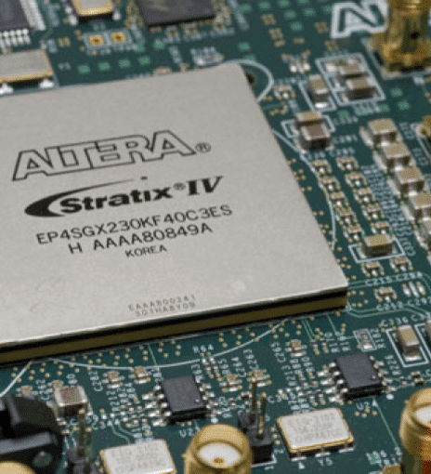
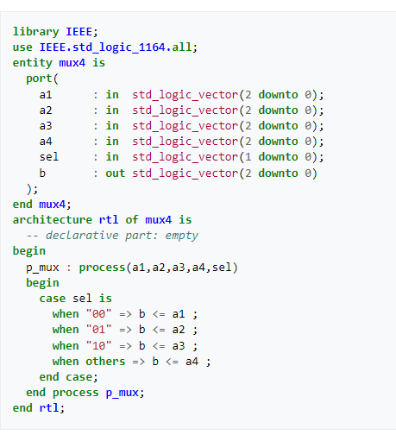
FPGA
This Photo by Unknown Author is licensed under CC BY-SA
Notes:
Looks just like any other integrated circuit (IC), doesn’t it.
Puts a multiplexer onto the chip
consist of an array of programmable logic blocks with a connecting grid that can be configured "in the field" to interconnect with other logic blocks to perform various digital functions

Slide 15
Basics:
Using the I.P.O pattern
Inputs
Processing
Outputs
Notes:
What inputs do I need for my system?
What processing am I doing on those inputs?
What results or outputs am I displaying to the user?

Slide 16

Types of Statements
Sequential
Ask for input from the console (cin >> variable)
Perform a mathematical calculation (int a = b + c)
Call a procedure/function/routine (sqrt(16))
Display a result (e.g., output) on the console
(cout << “I like Peppa Pig “ << endl;)
Notes:
Cin → console input
Cout → console output

Slide 17
Types of Statements
Conditionals
Evaluate an expression and choose a code path base on its results
if (this is true)
take the first course of action
else if (something else is true)
take that second course of action
else
default to that final course of action
Notes:
If (temp > 90.0)
Cout << “hot” << endl;
Else if (temp < 32.0)
Cout << “cold” << endl;
Else
Cout << “Okay ish” << endl;

Slide 18
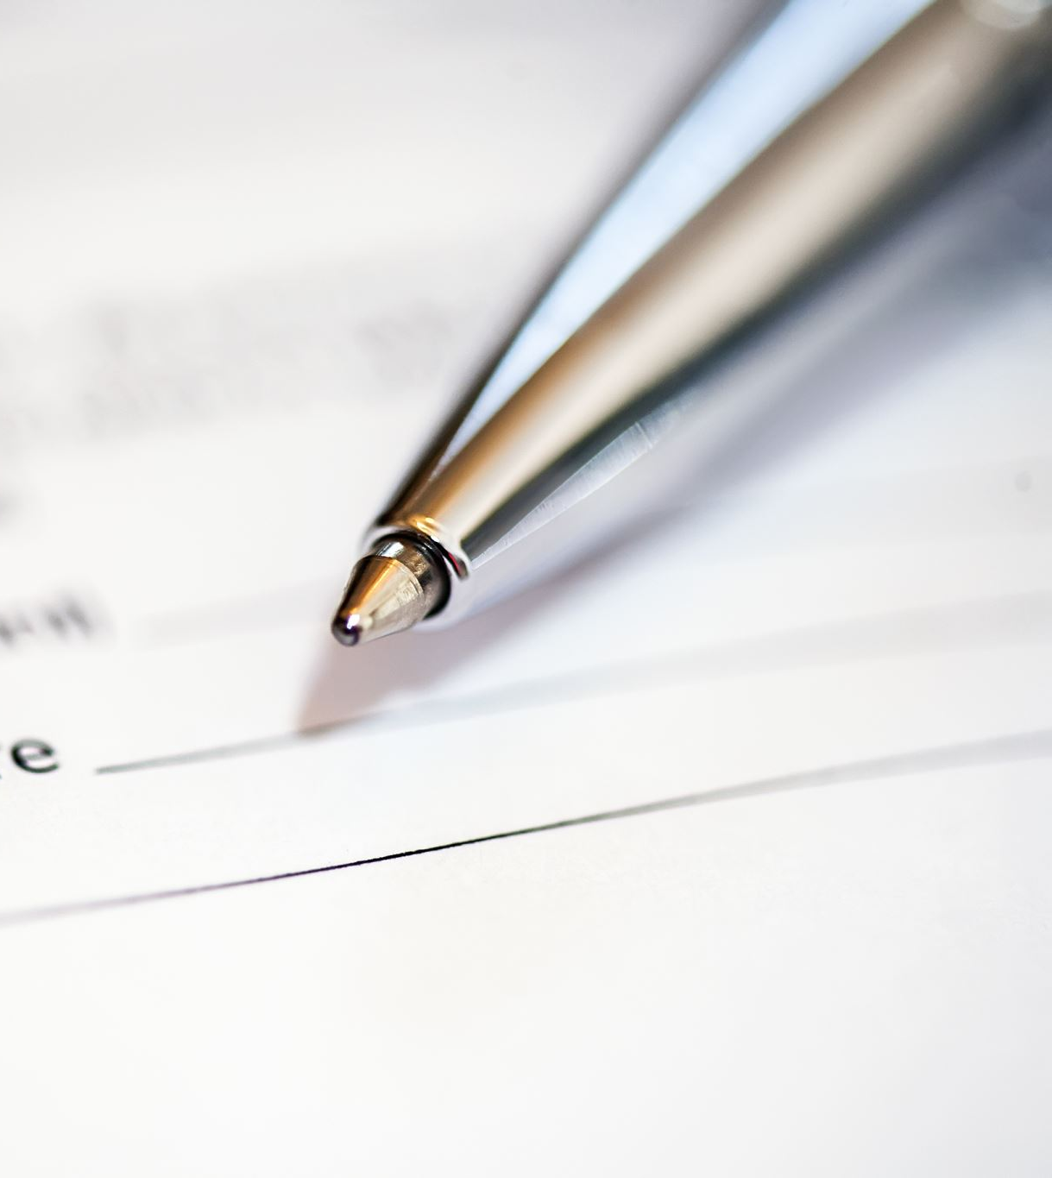
Types of statements
Iterative statements
Perform a sequence of actions repeatedly
Can repeat based on something becoming true (zero, one, multiple)
while (something is true)
statement 1
statement 2
…
statement n
Can repeat until something becomes false
do
statement 1
statement 2
…
statement n
while (something is true) // do this at least one time

Slide 19


Variables
Need to hold our inputs and intermediate values somewhere
Use variables
Not like math variables representing an unknown
Take up memory, computers don’t have unlimited resources

Slide 20

Datatypes
Each variable has to be represented by a datatype
Integers → Use byte/int/long
Decimals → Use float/double
Characters → Use chars
Strings → Use string
Tradeoff: range vs memory

Slide 21
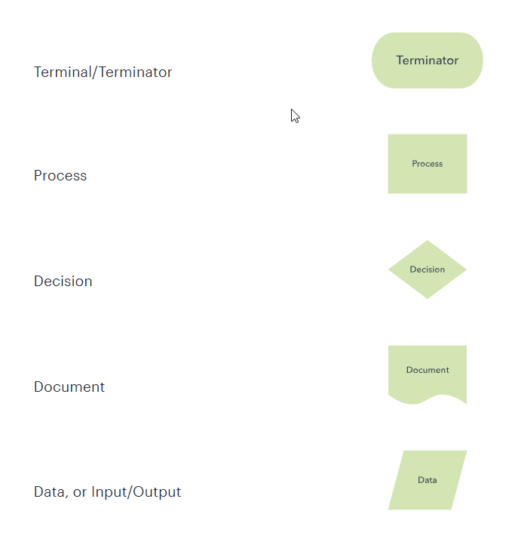
Flow Chart Model
Flow charts let’s us visually map out each step, decision, and repeated sequence of instructions
Notes:
Make sure everyone has a print out of at least 21-22
https://www.lucidchart.com/pages/what-is-a-flowchart-tutorial

Slide 22
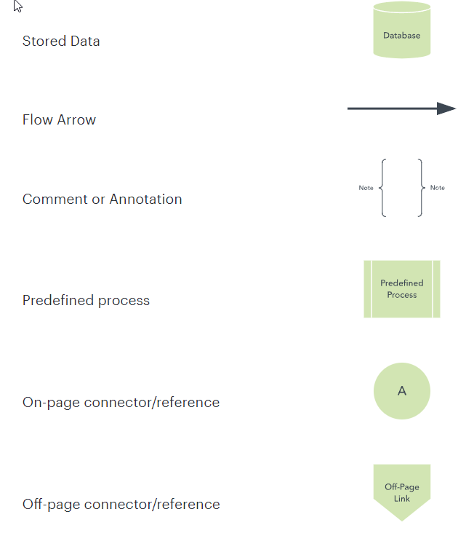
Flow Chart Model
Flow charts let’s us visually map out each step, decision, and repeated sequence of instructions

Slide 23
Let’s try a quick exercise
Imagine we go to the local carnival.
One ride costs one ticket
Do we have money?
If so, buy some ticket, otherwise go home
Wait in line, get on ride. Wonder is it over yet.
Ride it again if we still want to AND have at least one ticket.
Go to draw.io
Select Local Device, New Diagram, Basic Flowchart
Notes:
If the answer is "Yes," follow the arrow to the "Outdoor Activities" node.
If the answer is "No," follow the arrow to the "Indoor Activities" node.
Loop involve being bored?

Slide 24

How would we welcome a new person to camp and display their approximate age?
Notes:
// cin.ignore(); // stuff like this makes C++ challenging
// getline(cin, suffixes); // using #include <string>
#include <iomanip>
#include <iostream>// make code more modular, avoid name collisions in different libraries// otherwise, write std::cout or std::cinusing namespace std;void helloAgeExample()
{ // Need to hold data in variables, which are stored in memory // C and C++ are strongly typed languages, each variable indicates data type
string name; // store user's name in a string variable
int yob; // store user's yob in integer // Use the input, processing, and output pattern, start with a prompt
cout << "Name: "; // gather the name
cin >> name; // welcome this user and ask for yob
cout << "Hello " << name << " What year were you born?: " << endl; // get yob of birth and gustimate age with two examples
cin >> yob;
cout << "Oh, so you must be " << 2023 - yob << " years old or " << 2022 - yob << " years old. " << endl;}

Slide 25
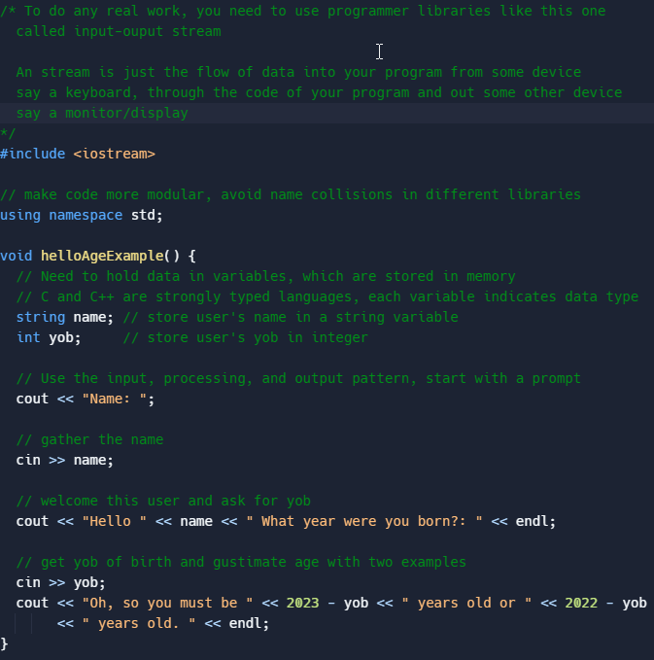
First Example Solution
Notes:
Go to https://replit.com/@mrobbeloth/SummerCampCExamples#main.cpp
Mention libraries like input-output stream
Using namespace blah means we type less
Mention data types: integers, floats (reals), chars, Booleans, and strings
Mention input and output statements (console input cin, console output cout)
Redirection characters >> (stuff it into a container) << (megaphone), where do you want the stuff to go or originate from
Endl end line carriage return stuff
Expressions in output statements vs calculating and placing result in variable
#include <iostream>
#include <format>
#include <chrono>
int main() {
const auto now = std::chrono::system_clock::now();
std::cout << std::format("{:%Y}", now); // => 2021
}

Slide 26
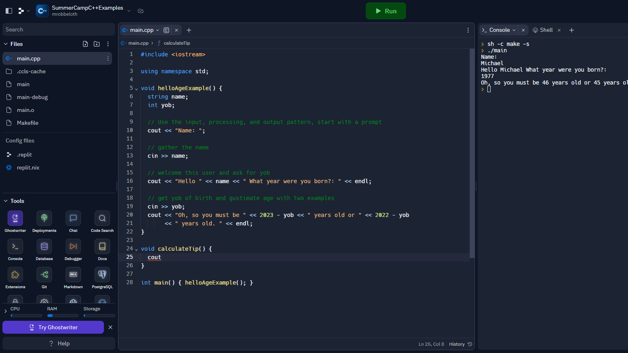
Example Running on Replit.com
Notes:
We press the Run button to run our code in the Console window

Slide 27

How would you calculate the tip?
Use draw.io to map out steps
Let’s write the pseudocode
Ask below (‘B’) expectations (10%), meet (‘M’) expectations (18%), or exceeded (‘E’) expectations (20%)
Keep using the IPO pattern
Next, translate each pseudocode instruction into a line of C++ code
How do you differentiate the service you got?
Tip: use cout << setprecision(2); and cout << fixed; to round amounts to two places.
What datatypes do we need to use?
Notes:
Conditional statements to the rescue
Ask for bill and store in a floating-point variable holding dollars and cents
Ask if service was below expectations, meet expectations, or exceeded expectations
If service was b.e., apply 10% tip to bill
Else if service m.e., apply 18% tip to bill
Else if service e.e. apply 20% tip to bill
Else report an error
Calculate tip as tipAmt = bill * tip
Calculate final bill as totalBill = bill + tipAmt with amounts rounded to 2 decimal places
Report tip and final bill

Slide 28

Solution to tip program

Slide 29
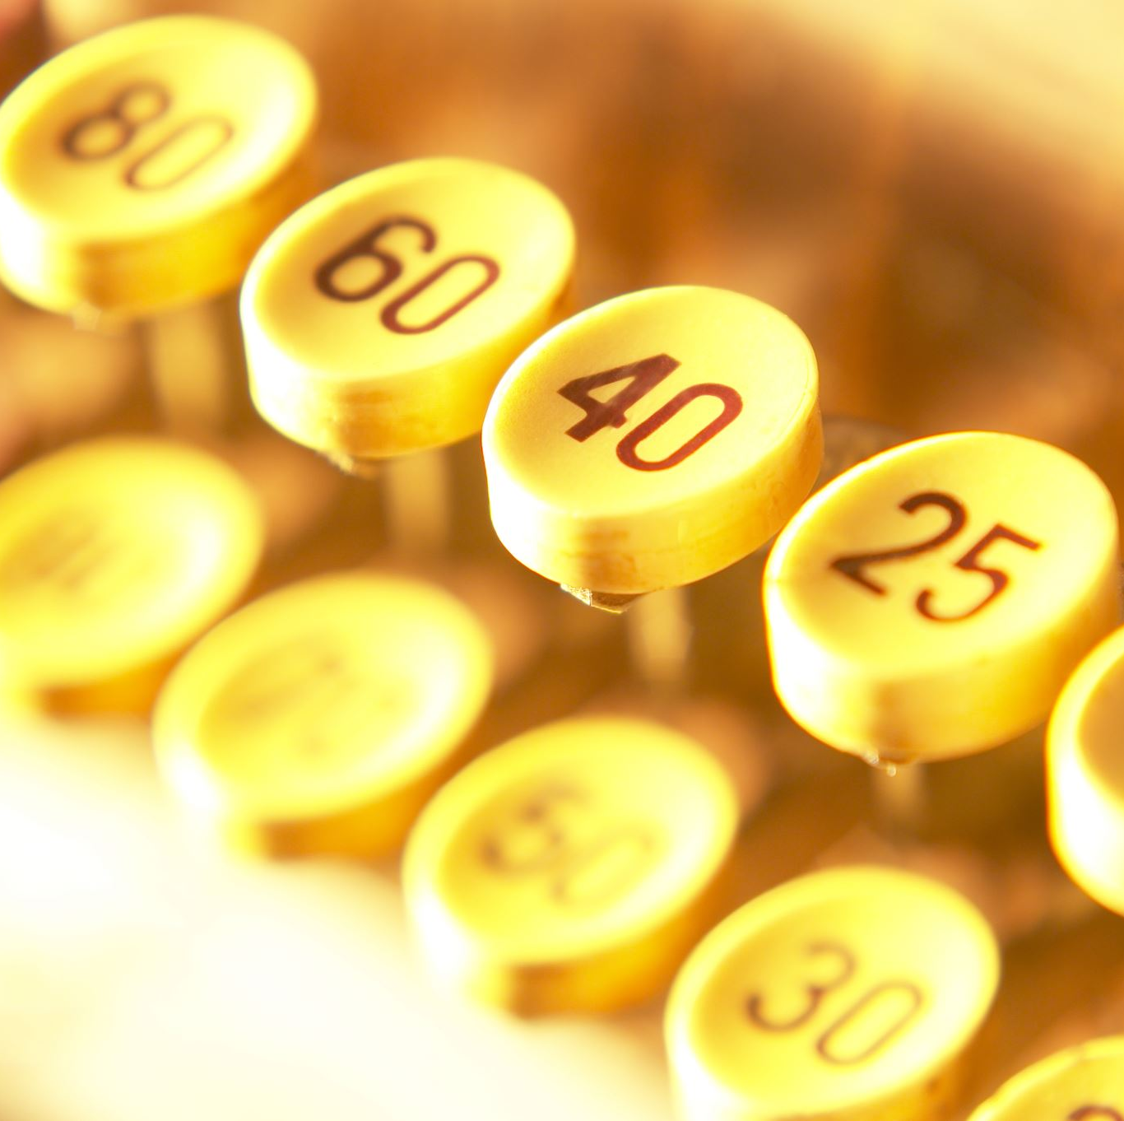
Let’s work with loops
What would it take to print from one number to another, say 1 to 10, and then give a sum of those numbers?
IPO
Inputs:
Processing:
Outputs:
Later, we’ll try to print the odds or evens from some start value to some end value based on user inputs.

Slide 30
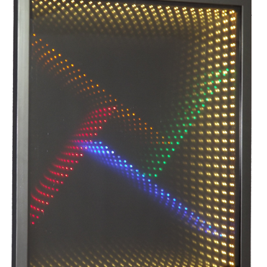
Infinity Mirror
2+ mirrors/mirror-like surfaces in parallel or angled arrangement
LED strip (60 lights total) will line the perimeter
Create series of ever smaller reflections toward infinity
Recursive due to Droste effect
Front-mirror must be one-way
Software code and electronics creating art

Slide 31
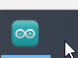

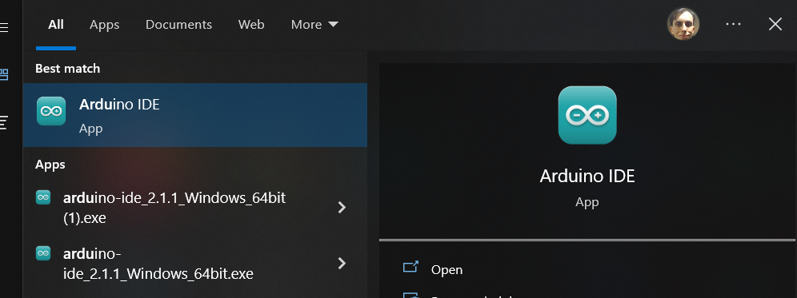
Arduino Overview
Click Start button and type Arduino and select Arduino result or look for the icon

Slide 32
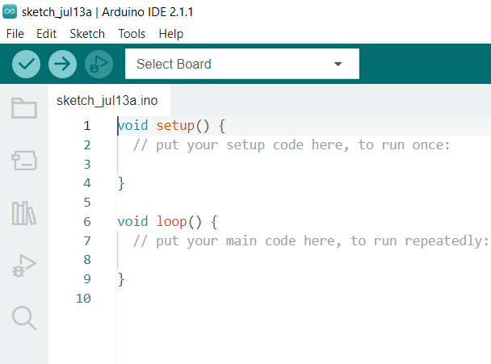
Arduino Environment Classic version Syntax is C++ compatible
Notes:
Arduino code is based on C++ code
Setup code runs when board powers up
Loop code runs continuously until you power off the board
Verify code by checking the checkmar
Load new code by pressing the play button
New, open, and save buttons
Sketch→Include Libraries for adding external code to support hardware like the ws2812 led strips

Slide 33
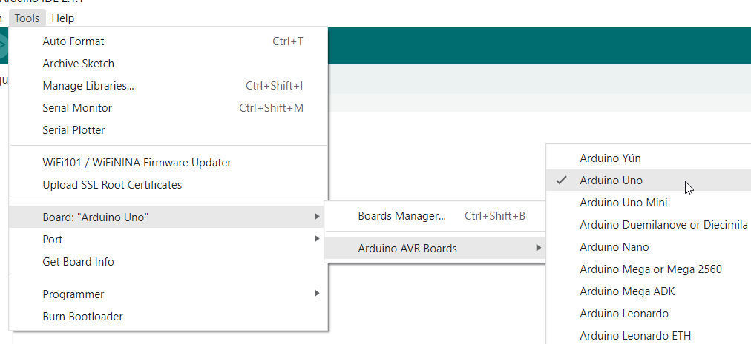
Make sure this board is selected
Notes:
1st exercise: Red only
2nd exercise : Make ½ blue and ½ red
3rd exercise: animation (may need help)

Slide 34
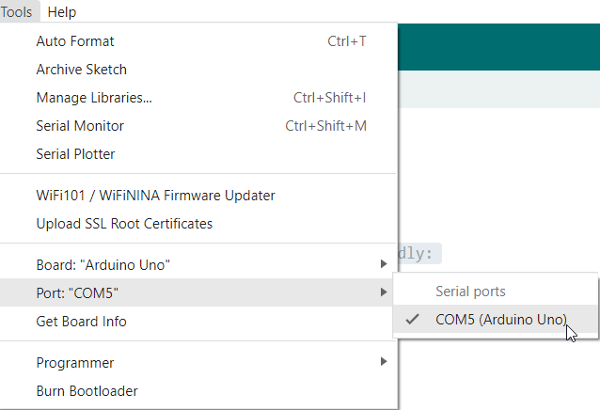
Make sure the correct serial port is selected

Slide 35
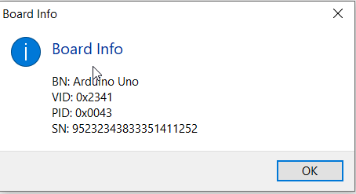
If the correct board and port is selected
Tools→Get Board Info
BN and maybe PID should be the same, but other values may vary. It’s okay
Notes:
Version ID
Product ID

Slide 36
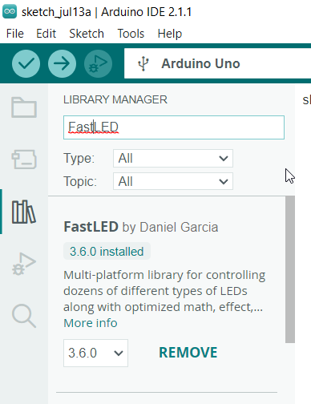
Library for LED Strips
Select 3.6 or later version
Tools→Manage Libraries
Enter FastLED into search box
Pick the one by Daniel Garcia.
Click Install
https://github.com/FastLED/FastLED/wiki/Basic-usage
In code, select new sketch and add as 1st line before setup() block:
#include <FastLED.h>
Notes:
https://github.com/FastLED/FastLED/wiki/Basic-usage
Ask questions, some of you may wonder, what’s the deal with the angle brackets? What does .h mean?
Ctrl+Shift+I to close

Slide 37

Next steps
Better to change code in one place than many places
Constants help us to do this
In C/C++, we can use #define
#define NUMBER_LEDS 60
#define DATA_PIN 6
Let’s do this after #include <FastLED.h> on line 1
Wherever NUMBER_LEDS appears in our code, the compiler will replace it with 60.
Notes:
What’s a compiler you may ask?

Slide 38

Now, we work on setup(), We need to add:
Need to declare globally an array of LED objects using the variable declaration:
CRGB leds[NUMBER_LEDS];
// Next add the following line in setup:
FastLED.addLeds<NEOPIXEL, DATA_PIN>(leds, NUMBER_LEDS);
FastLED is an CFastLED class object, addLeds is a method (specifically a factory method).
Yes, the period, angle brackets, parenthesis, and the semicolon are all important – part of what we call syntax
It says we have 60 LEDs we would like to use that are NeoPixel compatible (WS2812s) and are connected to pin 6.
Notes:
Ask students if they remember what setup does?
static CLEDController &addLeds(CLEDController *pLed, struct CRGB *data, int nLedsOrOffset, int nLedsIfOffset = 0);

Slide 39

Finally, let’s work on loop()
We need to use a construct that repeats a certain number of times
We call this a loop
In this case, we’ll use a special type of loop called the for loop
for(myVariable = start_value; myVariable < something_else; start_value++) {
// do something over and over again until myVariable equals something else
}
=, ==, <, ++, {, and } all mean something different, do you know what it is?
Notes:
void exercise1() {
// 1st exercise, turn all LEDs red
for(int dot = 0; dot < NUM_LEDS; dot++) {
leds[dot] = CRGB::Purple;
FastLED.show();
delay(10);
}
}

Slide 40
To get an LED to actually do something
We need to call a method, FastLED.show()
We may want to add delay(some milliseconds) to get interesting effects.

Slide 41
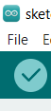
Verify the code
Click the checkmark icon
Sketch→Verify or CTRL+R
If you don’t see any red error text, that’s good
You can now upload the compiled sketch to the board

Slide 42
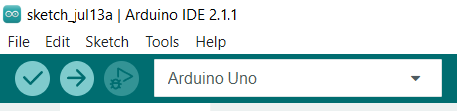
Upload the compiled sketch
Click the upload (play) arrow icon
Board should be selected
Sketch→Upload or CTRL+U
If you don’t see any red error text, that’s good
You can now upload the compiled sketch to the board

Slide 43
Q&A Break
Next two exercises, time permitting
Make ½ of the lights blue and ½ read
Finally, let’s animate all the lights
If there is extra time beyond that, let’s try something more challenging like different colors for odd/even lights or generate different random colors.
Notes:
2nd exercise : Make ½ blue and ½ red
3rd exercise: animation (may need help)
If exercise 6 is needed, talk about HSV vs RGB or adding/subtracting colors
Pontimotor could b

